Slide 1
Who is riding your bikes and why?
Presented by: Josh
Last Updated: September 2022

Slide 2
Problem
Solution
Discover ways to increase annual member counts and maximize profitability
Determine trends in ridership to guide data driver business decisions to provide better valuation for riders and the company alike

Slide 3
Objective
To discover the trends between Members and Casual Riders to better utilize rideable availability, increasing customer happiness and company profit

Slide 4
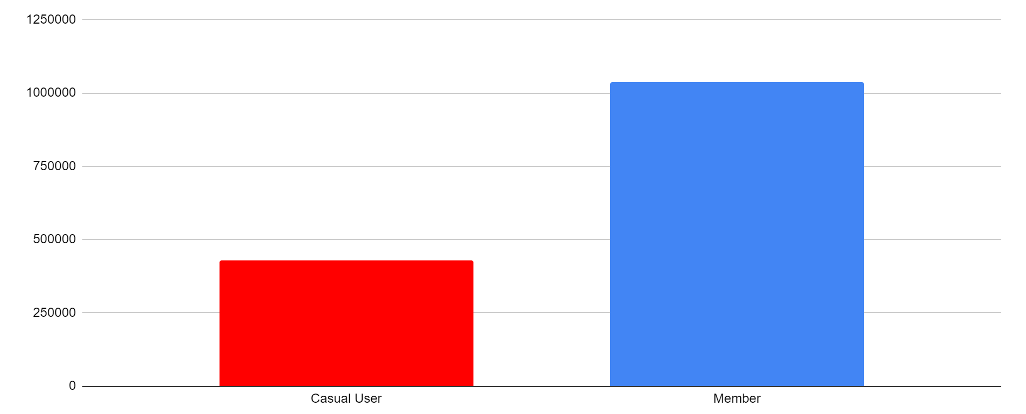
Member Type Distribution
2.4 Times More!
Notes:
Note: Members outweigh Casual Riders by 2.4x
Propose question of why focus on Casual users

Slide 5

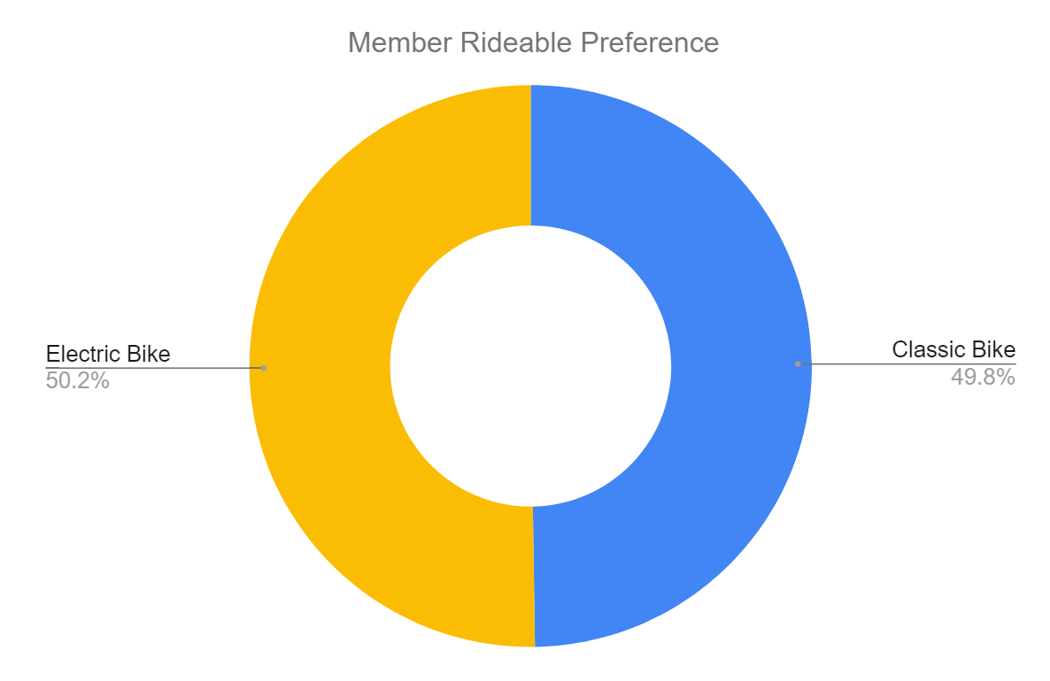
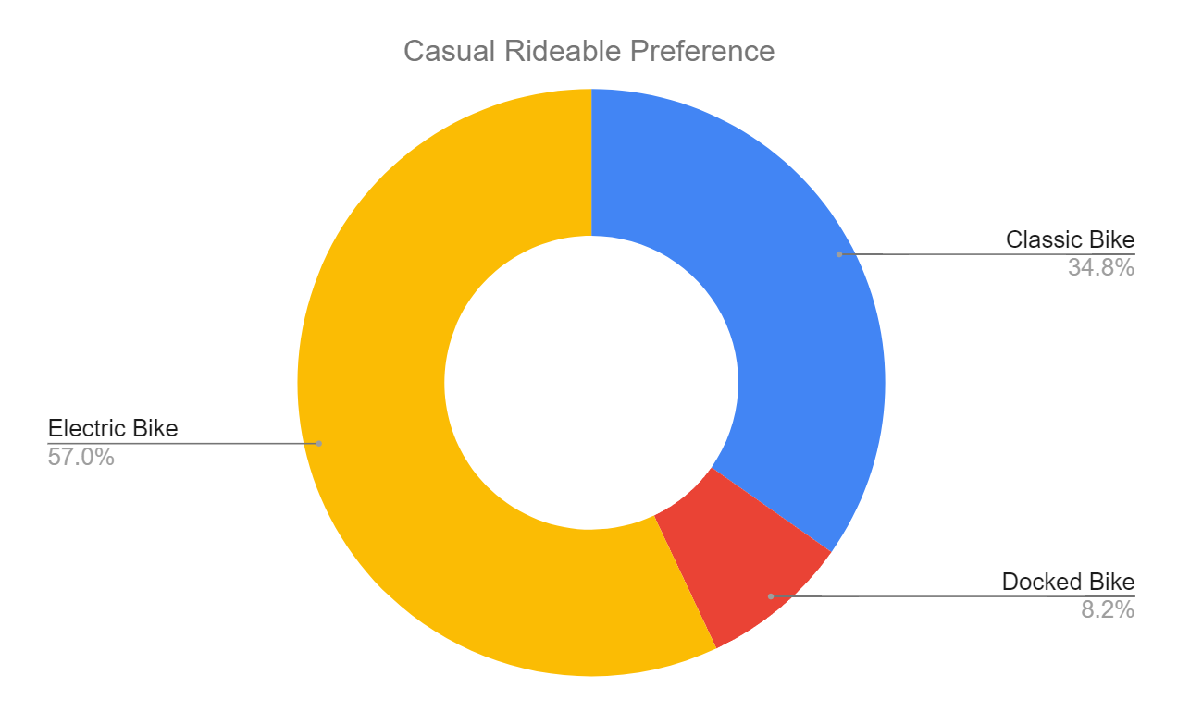
Rideable Preference
Members are virtually split
Casual riders prefer electric
But why?
Notes:
Describe graph attributes
7% more electric use among casual users
Classic and Docked bikes combine for 43%

Slide 6
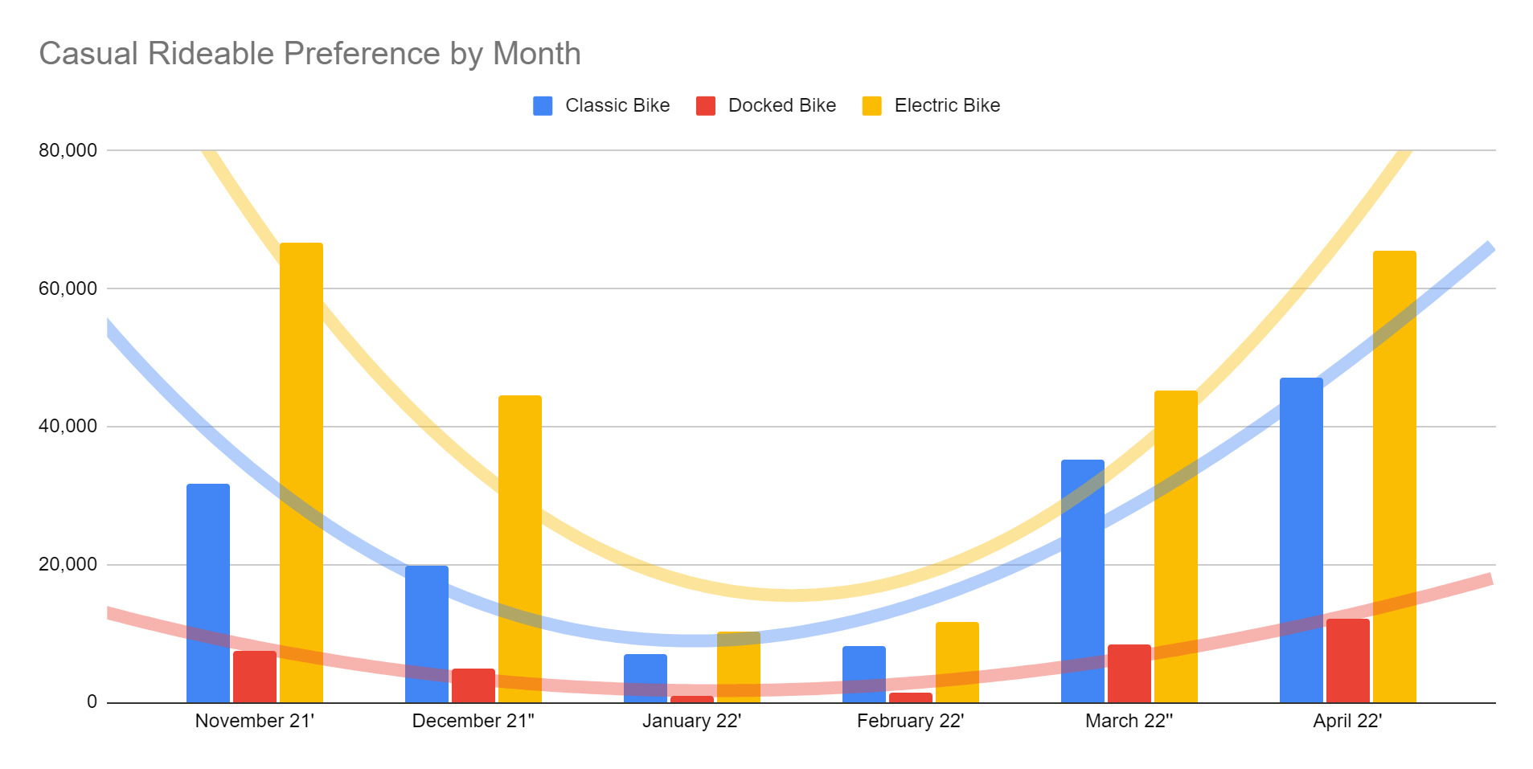
Casual Riders
Ride counts increase with warmer weather
Greater variation in electric month to month
Docked bikes have the lowest variation of use
Notes:
Note uptick in Docked usage as Electric and Classic rental increases
Note relatively flat trendline in Docked

Slide 7
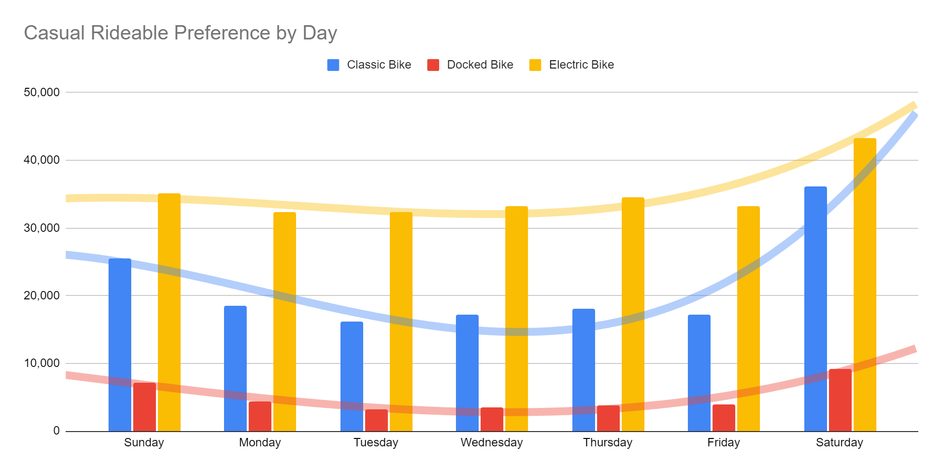
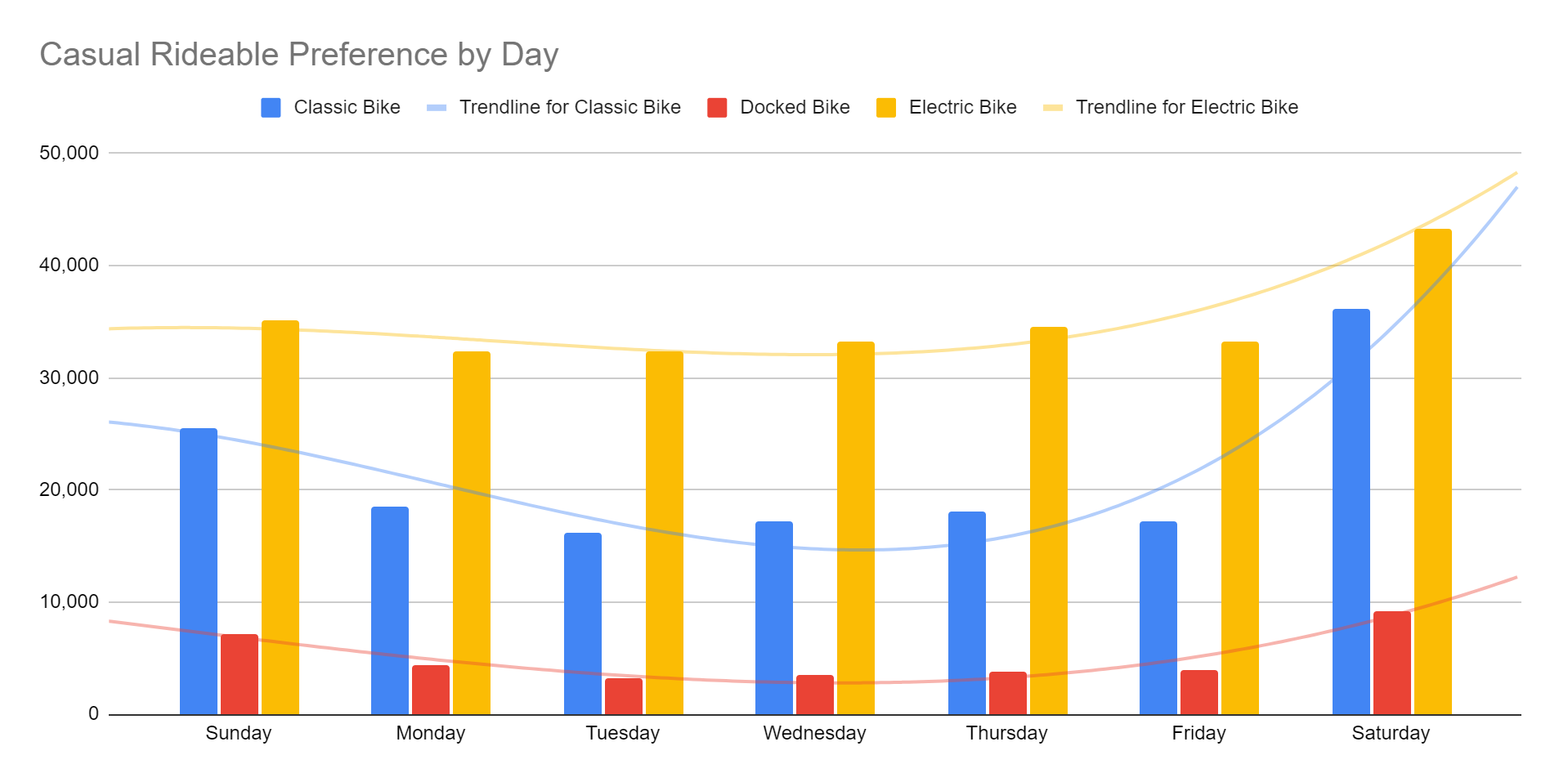
Casual Riders
Docked bikes remain fairly consistent
Electric has slight uptick on weekends
Severe jump with classic bikes on weekends
Notes:
Note the flatter use of Electric over time
Trend of Classic use on weekends outpaces other rideables

Slide 8
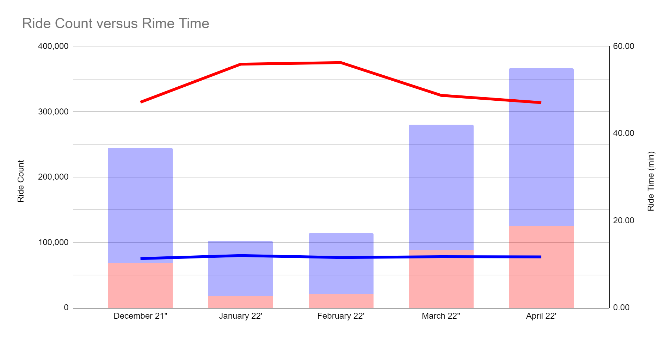
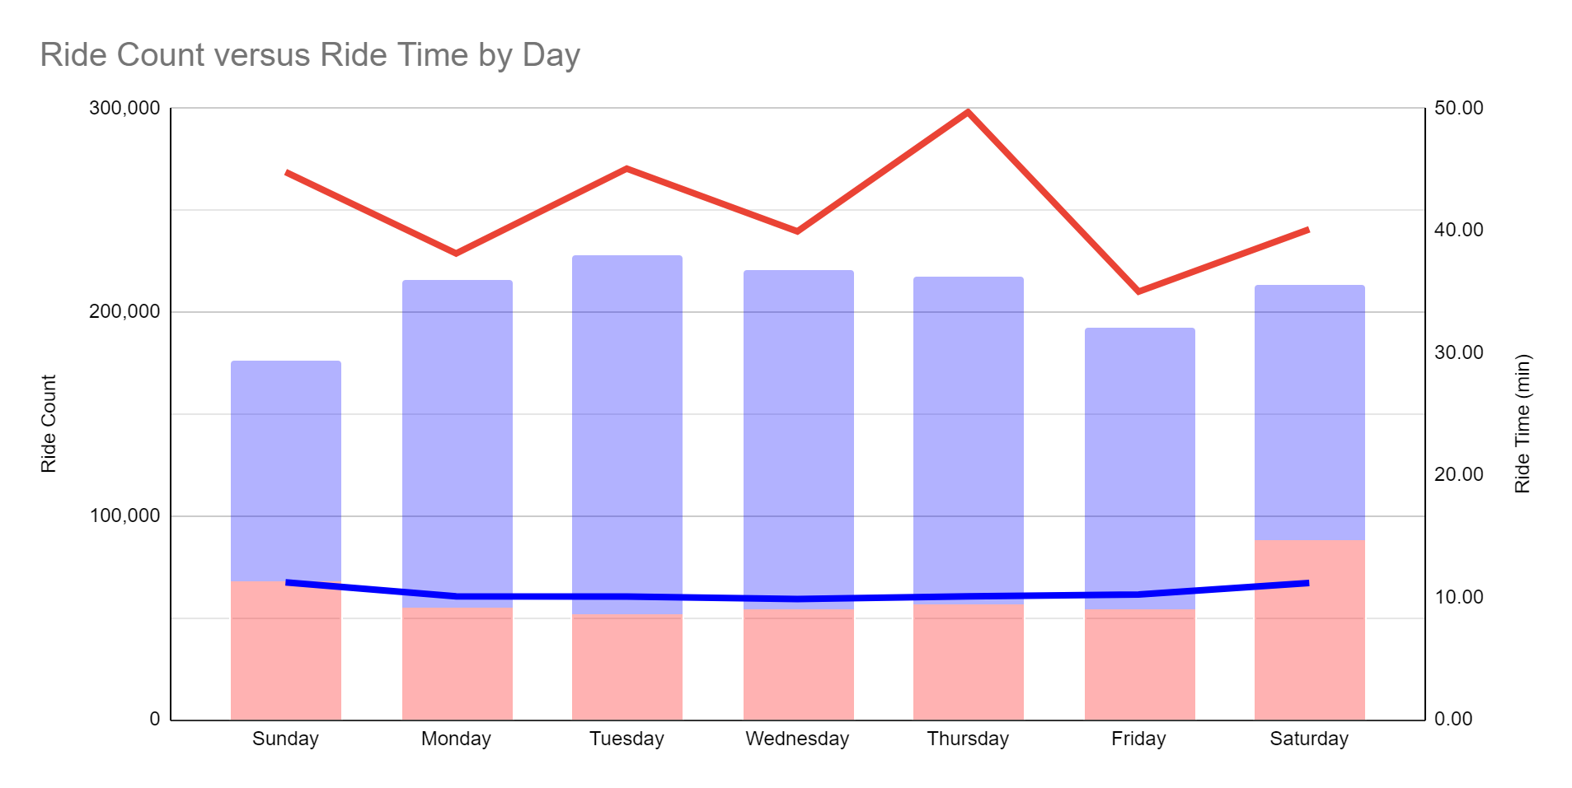
Ride Time vs. Ride Count
Members over doubles Casual Users in Ride Count on average
Casual Users ride four times longer than members on average
Notes:
Describe graph attributes
Acknowledge difference between member and casual ride count
Note the trend in ride time across the monthly and weekly view

Slide 9
Conclusion
1
2
3
Accounting for combining Docked and Classic Rideables among Casual Member, there is a 7% delta between Member Type
Docked bike rental seem to be the increase when availability is low due to weekend volume of other rideables
Casual riders heavily outweigh Members in ride time, while Members, expectedly, over double Casual Rider ride counts
Notes:
1) While 7% isn’t insignificant, it is still small enough to consider a reduction or transition away from the docked bikes
2) Use this conclusion to reinforce conclusion 1
3) Use to point out the profit opportunity in casual riders

Slide 10
Recommendations
Introduce multiple tiers of membership through a social media and digital marketing campaign to capitalize on the longer Ride Times of Casual Riders.
Offer Casual Riders one-time discounts on Membership and introduce them to the benefits of becoming a member.
Offer discounted rental rates for Docked Bikes on weekends to help disperse the distribution of rentals.
Notes:
Comment on how a tiered membership programs can bring in more casual riders to become members
Comment on second recommendation as a use to increase membership count depending on the performance of the first
Comment that the third recommendation is to see how users react to using docked bikes, and offer consideration for phasing them out over time long term

Slide 11
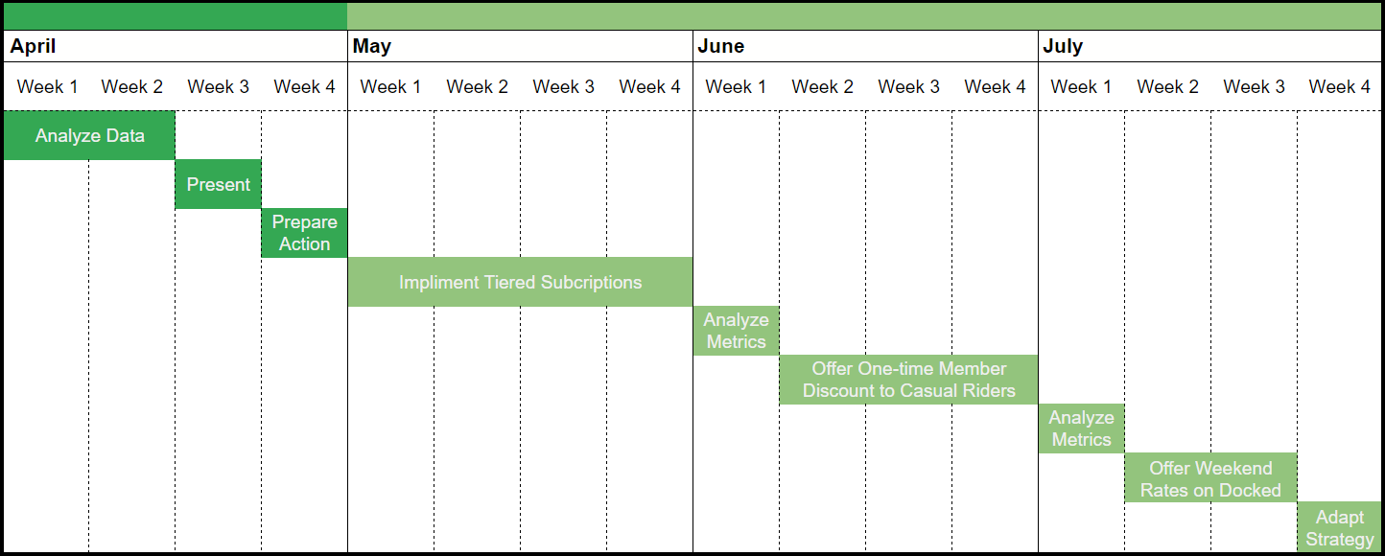
Implementation Timeline

Slide 12
Thank You!
Notes:
Offer thanks and take questions

